Slide 1
RESOLUTE US
One-Year Clinical Outcomes from the Pivotal Multicenter RESOLUTE US Study
Objective
To evaluate the clinical effectiveness of the Resolute zotarolimus-eluting stent (R-ZES) in a US population
SUBJECTS
1,402 patients with de novo lesions in native coronary arteries
PRIMARY ENDPOINT
12-month target lesion failure (TLF) defined as the composite of cardiac death, myocardial infarction (MI), and clinically-driven target lesion revascularization (TLR)
CONTROL
Historical data from Endeavor zotarolimus-eluting stent (E-ZES) trials, adjusting for baseline covariates through propensity scores

Slide 2
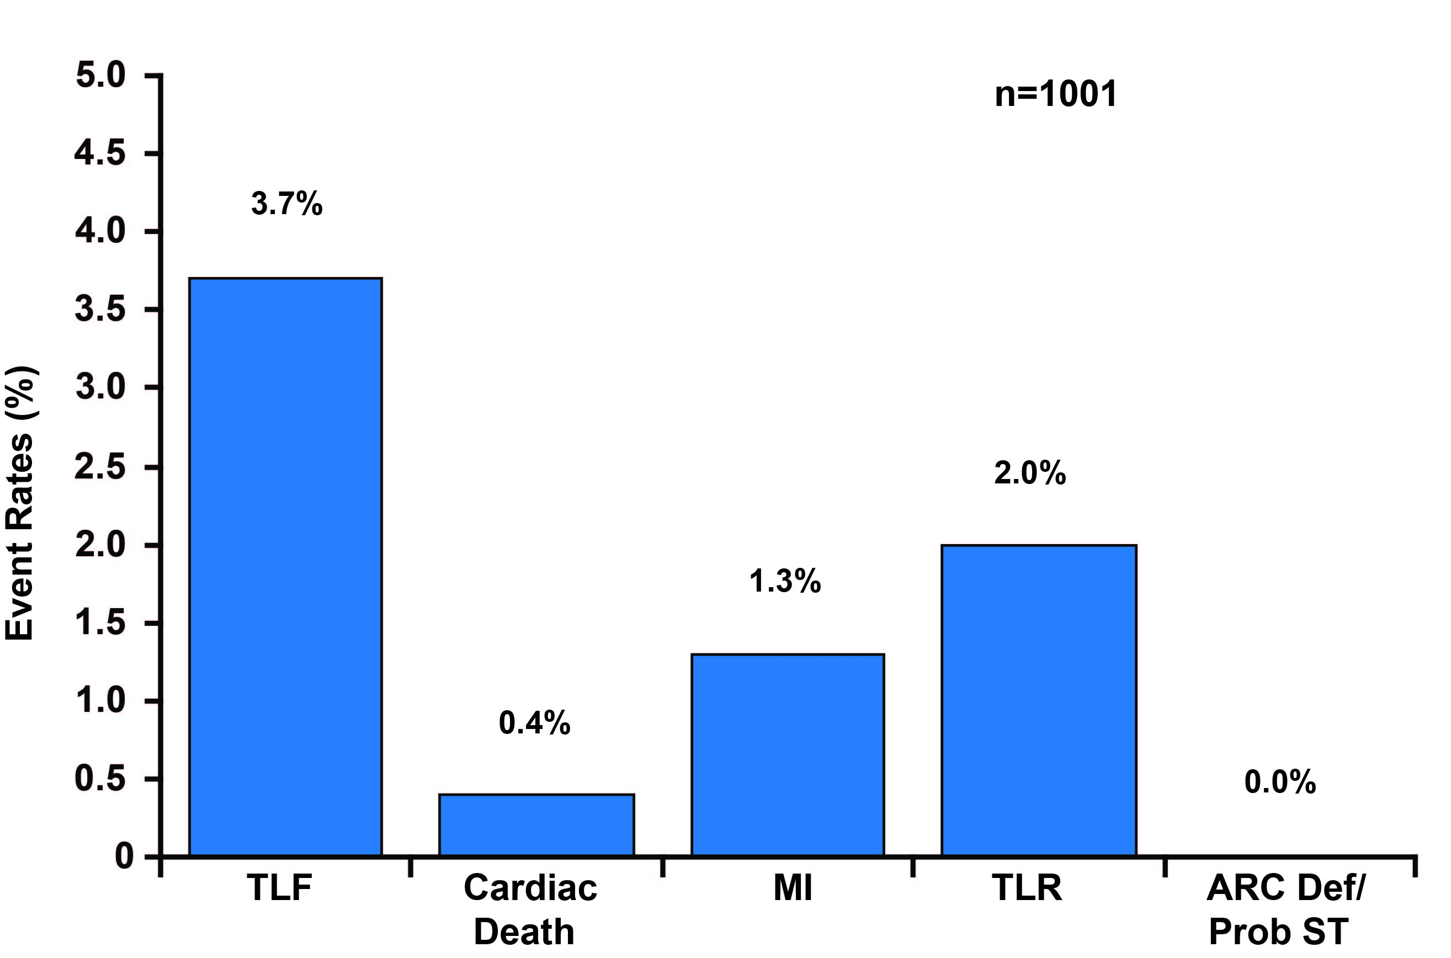
RESOLUTE US
12 Month Results
TLF was 3.7% in R-ZES versus 6.5% in historical E-ZES data
R-ZES met the 3.3% margin of noninferiority
Overall TLF rate was 4.7

Slide 3
RESOLUTE US
Conclusions
Very low rate of clinical restenosis and low need for repeat revascularization that was achieved on very high compliance of dual antiplatelet therapy are reassuring for challenging patients with diabetes mellitus and small-sized vessels
Low rates of important clinical safety events, such as death, MI, and stent thrombosis (similar rates with R-ZES compared with earlier E-ZES)
Further trials are required to demonstrate long-term efficacy and safety of the R-ZES

